Slide 1
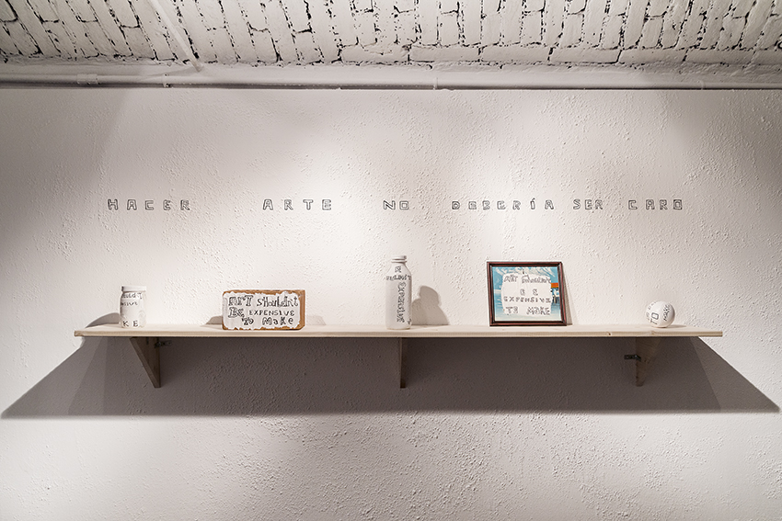
Notes:
Give students a minute or two to view the image. Then guide their visual analysis and group discussion by asking:
1. How many objects are on the shelf? (five)
2. Can you make out any words on the objects?
3. What does it say on the wall? (hint: the second object from the left on the shelf, a brick, is a translation)
4. What do they all have in common? (they are all inexpensive items)
5. What do you think the artist is trying to say with this work?
Background on work
• Art Should Not Be Expensive to Make (Hacer Arte No Debería Ser Caro), 2014
This existing work consists of a shelf and five handmade, inexpensive items. The text appears written on the wall over the shelf in Spanish and in English on the items.
Among other things, the work is a commentary on the difficult economic conditions in Cuba and the scarcity of materials; artists must make do with what is available.

Slide 2
Art Should Not Be Expensive to Make (Hacer Arte No Debería Ser Caro), 2014
Notes:
The artist is also commenting on the proliferation of international art with a celebrity that is inseparable from the high costs of its production.

Slide 3
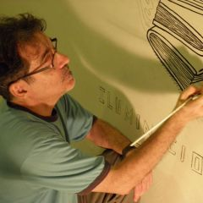
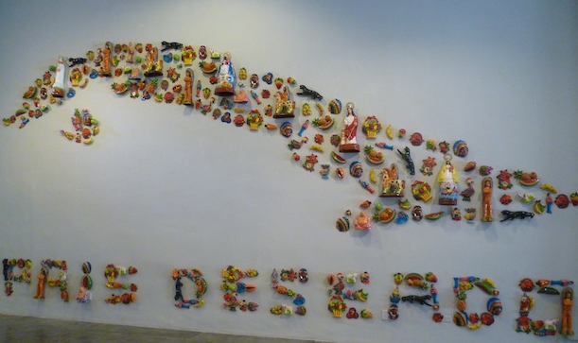
Antonio Eligio Fernández
“Tonel”
Notes:
Image sources:
http://www.museodeartecarrillogil.com/coleccion/artistas-de-la-coleccion/antonio-eligio-fernandez-quottonelquot
http://havana-cultura.com/en/havana-cultura-news/retrospective-exhibition-works-antonio-eligio-fernandez-tonel

Slide 4
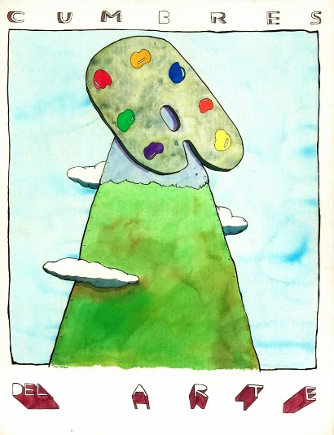
TONEL - ANTONIO ELIGIO FERNÁNDEZ
b. 1958, Havana, Cuba
lives and works in Havana; San Francisco, CA; and Vancouver, Canada
is an artist, writer, and curator
degree in art history from the University of Havana in 1982
has exhibited at many institutions in Cuba and abroad
notable awards:
International Art Critics Association (AICA) , 1991
Rockefeller Foundation Fellowship in the Humanities , 1997-1998
Guggenheim Foundation Fellowship for painting and installation art, 1995

Slide 5
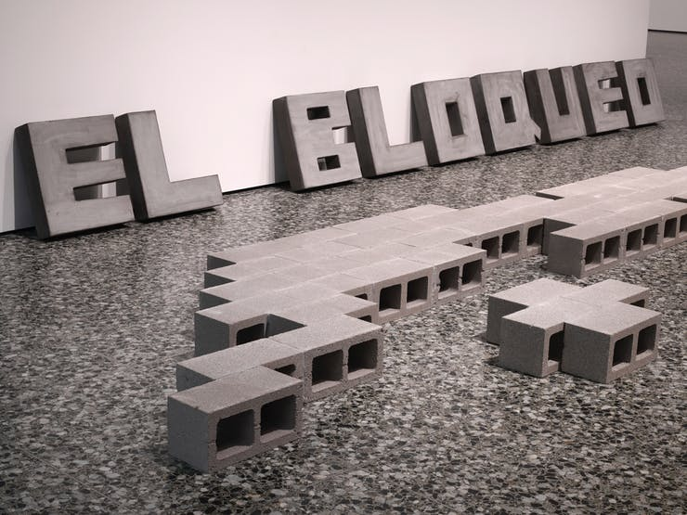
El Bloqueo (The Blockade/ The Embargo), 1989
Notes:
Image source: https://walkerart.org/magazine/adios-utopia-cuba-olga-viso-essay
Tonel (Antonio Eligio Fernández), El bloqueo (The Blockade/The Embargo), 1989. Collection of the Museo Nacional de Bellas Artes de La Habana and Daros Latinamerica Collection, Zurich. Image courtesy the Museum of Fine Arts, Houston. Photo: Will Michels

Slide 6
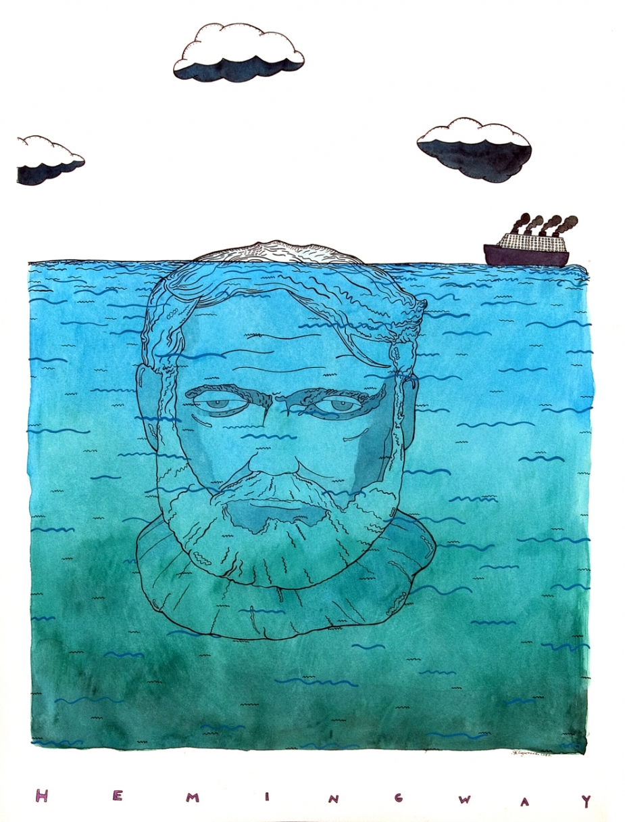
Hemingway, su técnica (Hemingway, His Technique), 1989
Notes:
Hemingway, su técnica / Hemingway, His Technique, 1989
Width: 50cm ; Height: 65cm
Medium: Painting - watercolor on paper
“In his 1989 drawing Hemingway, su técnica (Hemingway, His Technique), Tonel had used the submerged head of the American writer, peeking just a few centimeters above the water line, as a reference to his literary technique of the ‘’iceberg.’ “ This technique in writing, coined by American writer Ernest Hemingway, is expressed by believing the deeper /central meaning of a story should not be evident on the surface, but should be implicitly conveyed.
Source: http://www.thefarbercollection.com/artists/tonel_antonio_eligio_Fernandez

Slide 7
In Praise of Darwinism (Elogio del Darwinismo), 2010/2017
Notes:
In Praise of Darwinism (Elogio del Darwinismo)
This work consists of five letters made from poured concrete in a block form, arranged in a line on the floor. The crudity of the concrete blocks recalls the domestic construction techniques commonly used in Cuba.
The letters spell out “asere,” a popular colloquial and affectionate Cuban word of African origin that means “brother, pal, friend, relative, associate, etc.” The “s” is made to look like a dollar sign $. The artist is referring to the market’s/money’s conquest of Cuban imagination, thought, social space, and affections.
It represents a process of mutation, in an evolution of a species similar to the process described by Darwin. The artist rejects the application of Charles Darwin’s theory of evolution --- specifically the idea of the “survival of the fittest” --- to human society.

Slide 8
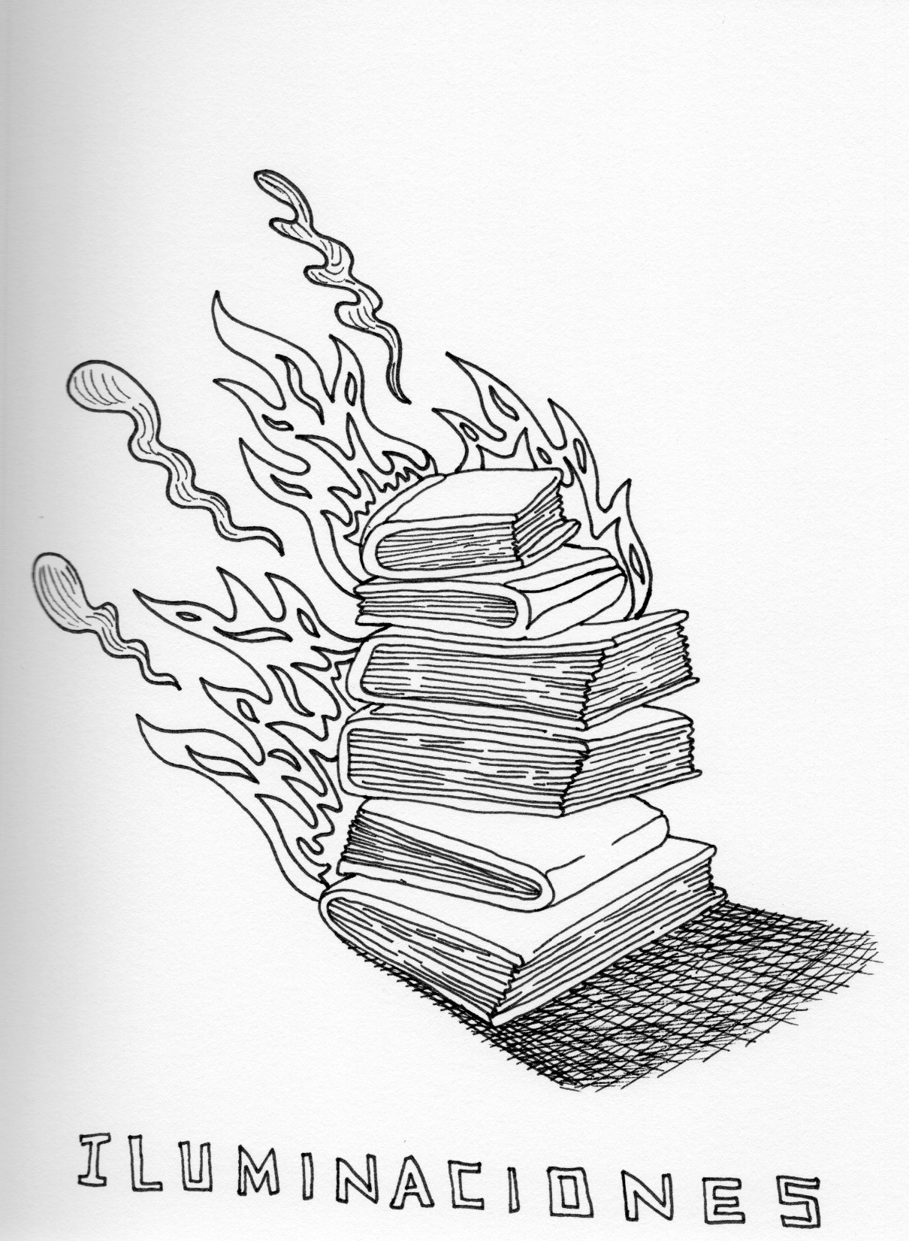
Iluminaciones (Illuminations), 2012/2017
Notes:
This large-scale drawing plays homage to German Jewish philosopher Walter Benjamin. A book by the same title, Illuminations, is a collection of Benjamin’s most celebrated works.
In 1940, at the age of 48, Benjamin committed suicide at the French–Spanish border while attempting to escape from invading Nazi forces.

Slide 9
What would you do…?
…if you were an artist and wanted to make commentary on a social issue, what issue would it be?
…if you were an artist with limited resources, what materials might you use?
Notes:
Tonel, Pais Deseado (
Source: http://havana-cultura.com/en/havana-cultura-news/retrospective-exhibition-works-antonio-eligio-fernandez-tonel

